Slide 1

Time to think
Two eggs
Notes:
1. 2 buckets (4 liters and 9 liters) get 6 liters of water
2. 2 sandglasses (4 mins and 7 mins). Measure 9 mins

Slide 2


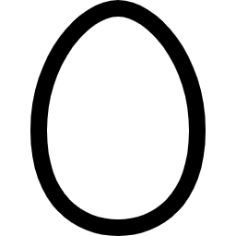
We are in front of a very tall building with 100 floors

Slide 3
We have 2 eggs that starts breaking
when it is thrown away from xth floor

Slide 4
That is, if you throw the egg from a floor lower
than x, it does not break.

Slide 5
That is, if you throw the egg from a floor lower
than x, it does not break.
And you can reuse the egg if it is not broken.

Slide 6
But if you throw the egg from xth floor or higher, it breaks.

Slide 7
But if you throw the egg from xth floor or higher, it breaks.

Slide 8
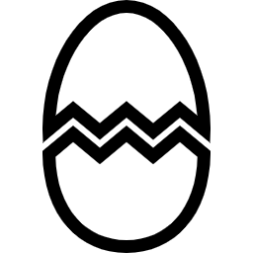
But if you throw the egg from xth floor or higher, it breaks.

Slide 9
In the unluckiest case,
How many trial do you need
to figure out the value of x?

